Slide 1
What’s in
My
Refrigerator
MAD DATA 23
Team KIMS

Slide 2
TABLE OF CONTENTS
01
02
03
04
Aims
Data Collection
Skills
Limitations

Slide 3
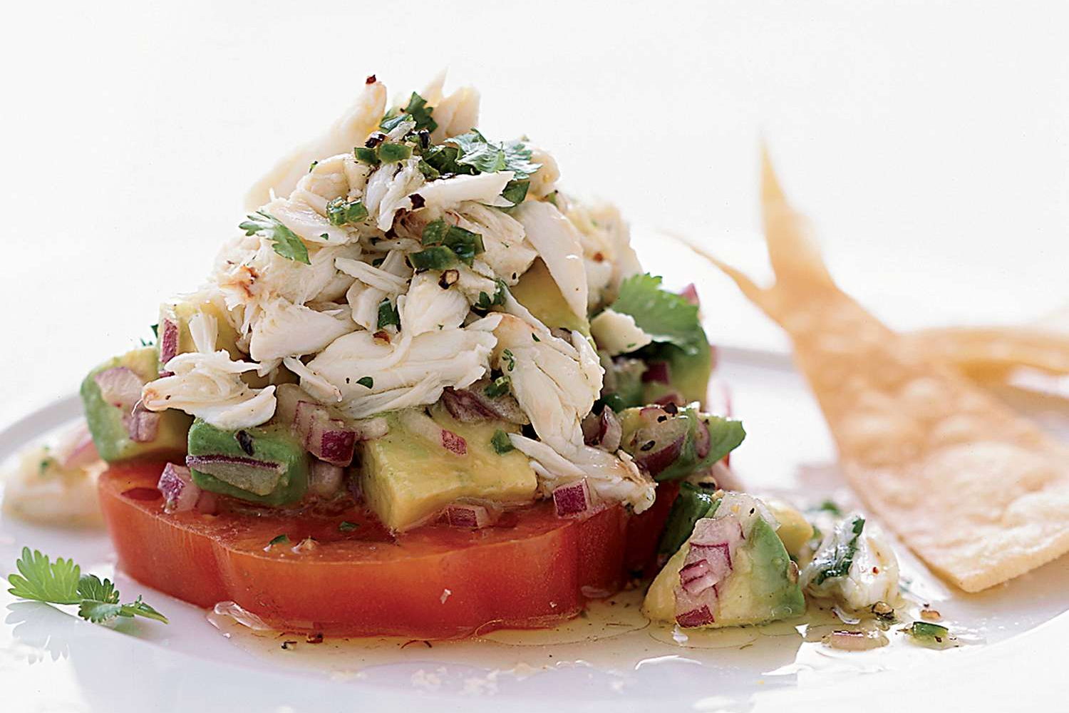
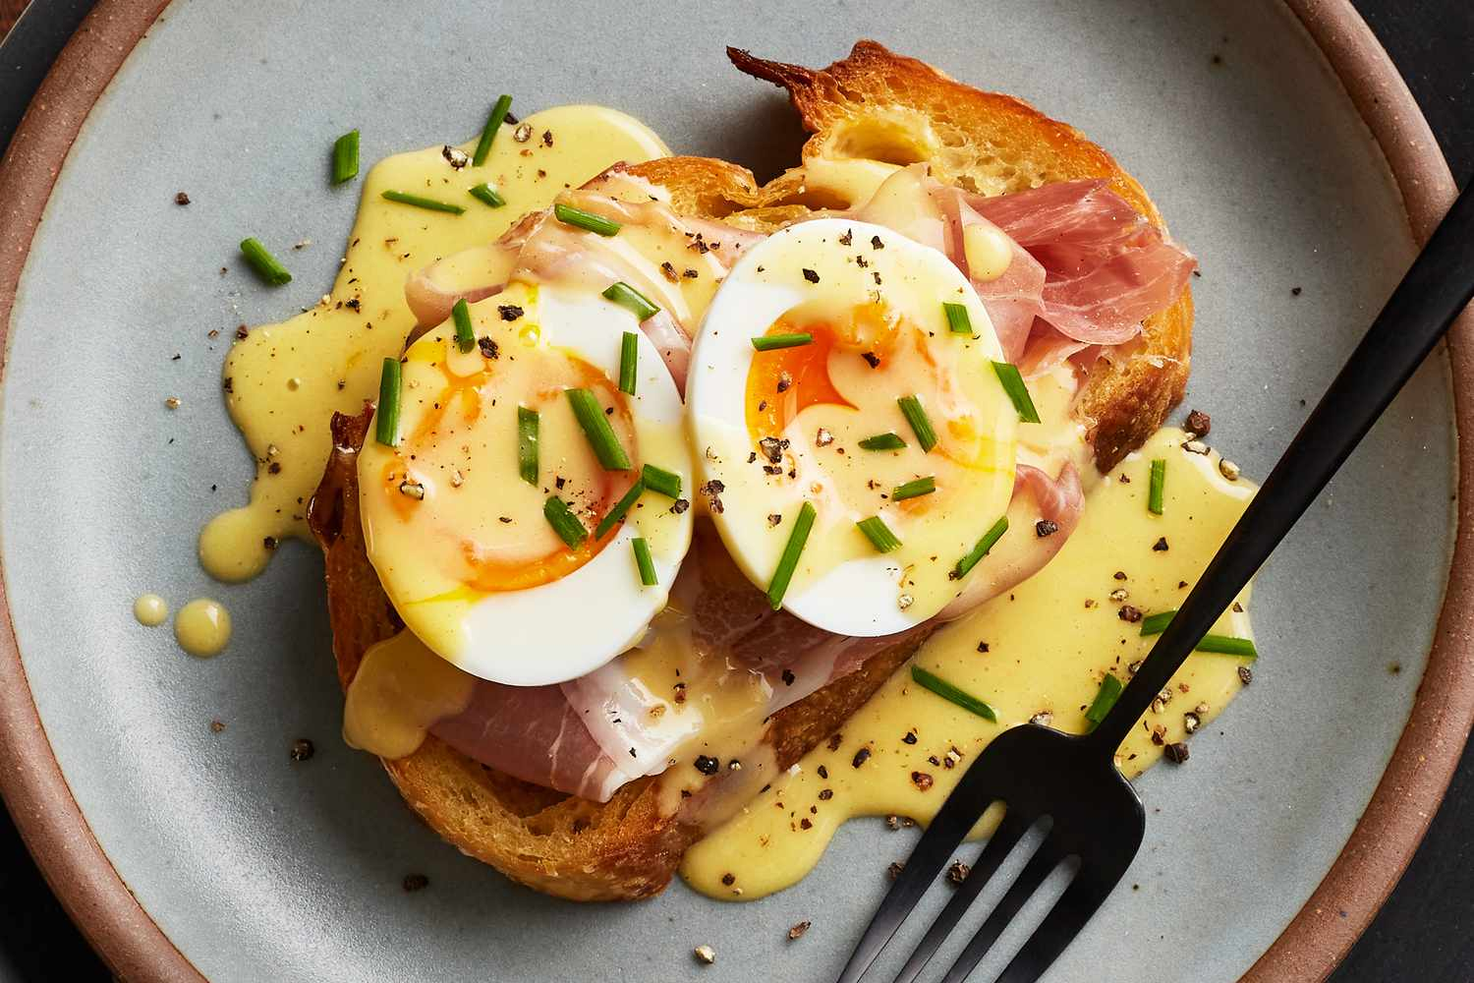
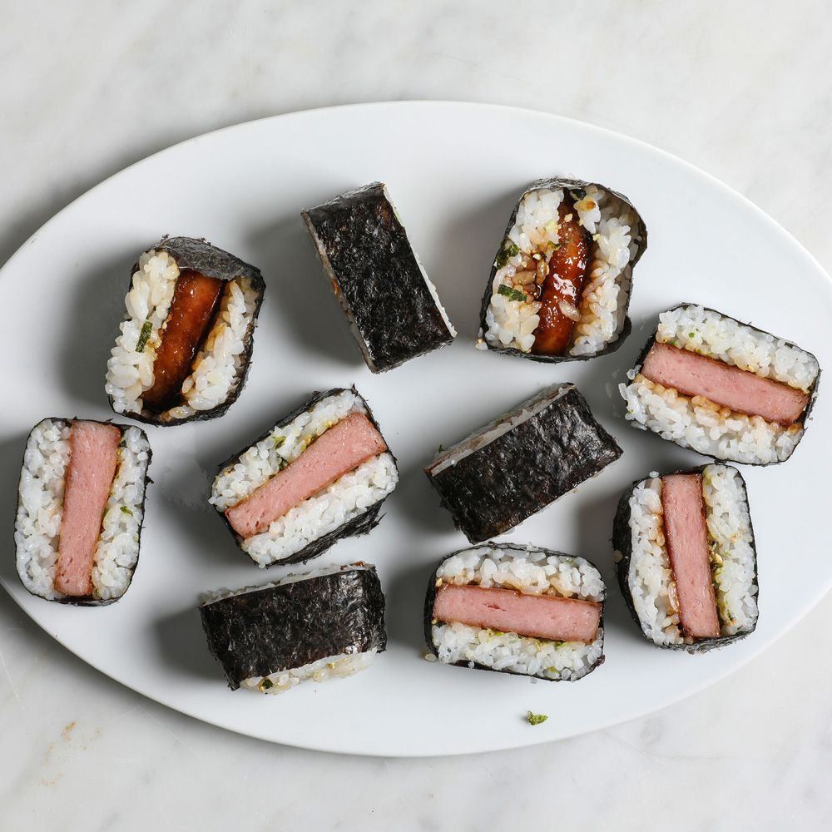
01
Aims
1. Encourage healthy eating habits by providing recipes that can be made using ingredients that are already in the refrigerator.
2. Refrain from unnecessary consumption due to climate issues.
3.Recommend reduction of unnecessary eating out costs.

Slide 4
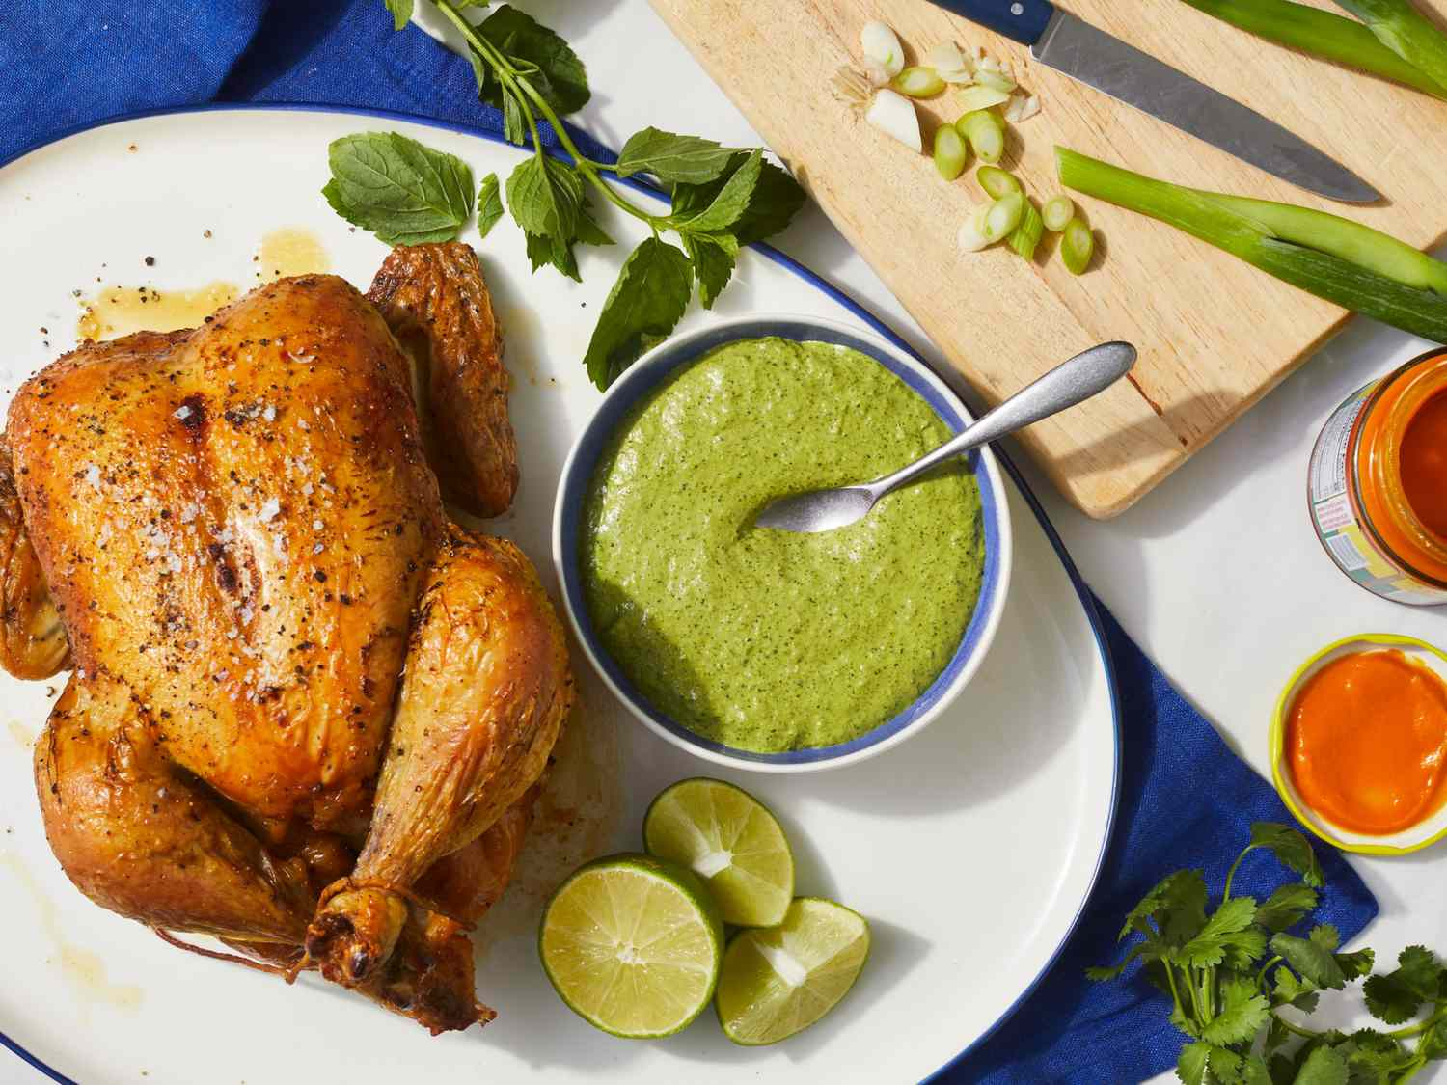
02
Data Collection
Data Source: Website (Web Scraping)
Collection Method: Web scraping using Python libraries such as BeautifulSoup, requests, and Pandas
Processing: Analyzing the scraped data, extracting the required information, and storing it in a database as CSV file

Slide 5
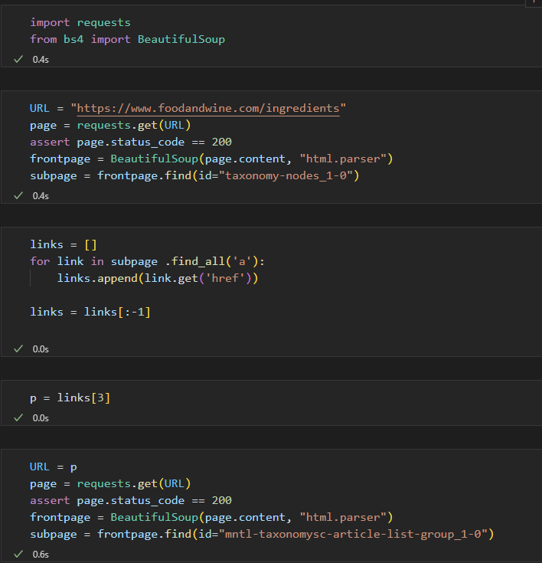
02
Data Collection

Slide 6
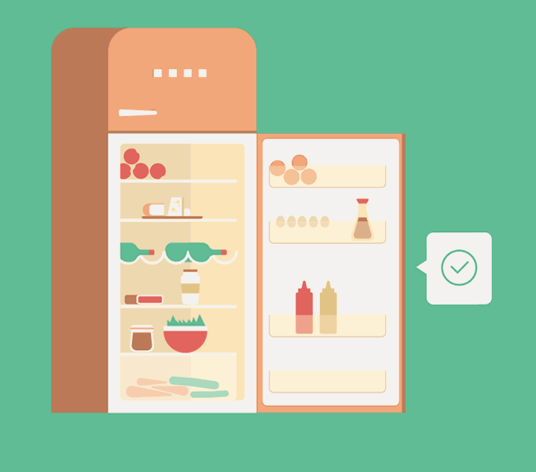
PROJECT DEMO

Slide 7
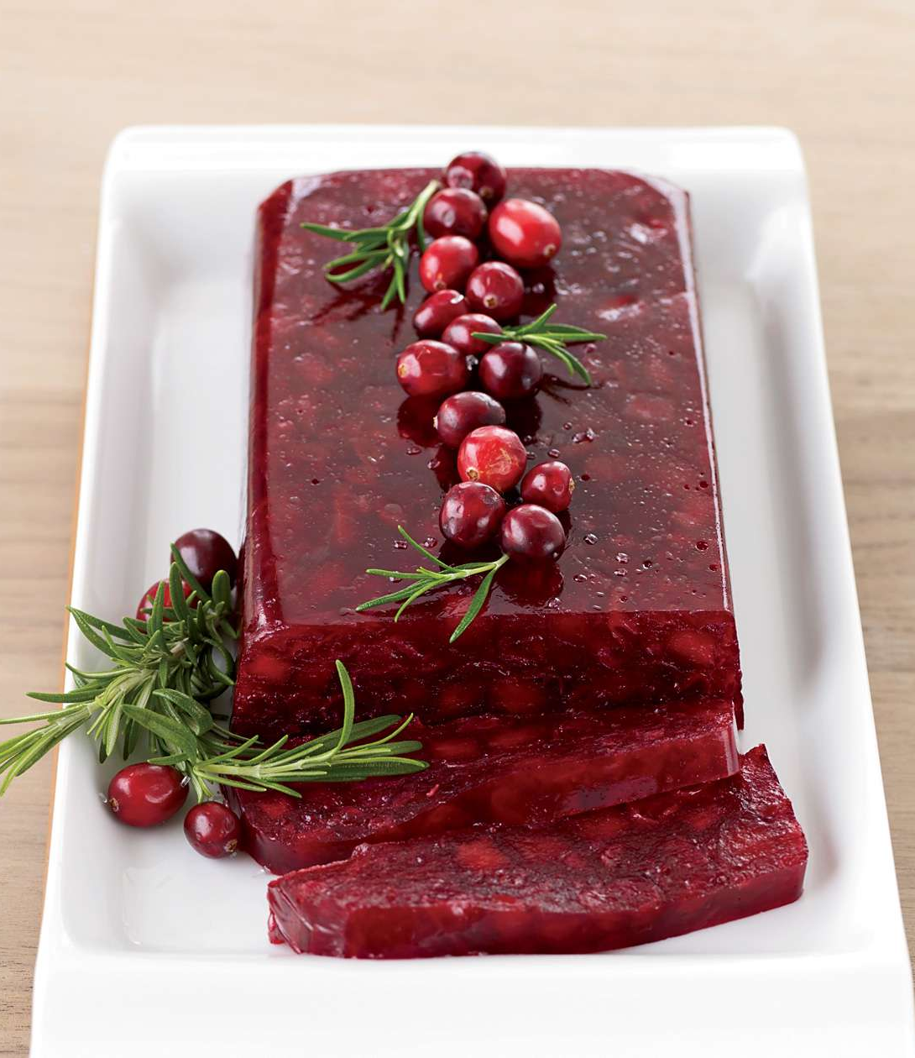
03
Skills
Python: Used for web scraping, data processing, data storage, and web Framework
JavaScript: Used for website functionality implementation and data visualization
CSS: Used for website design and layout
HTML: Used for website structuring

Slide 8
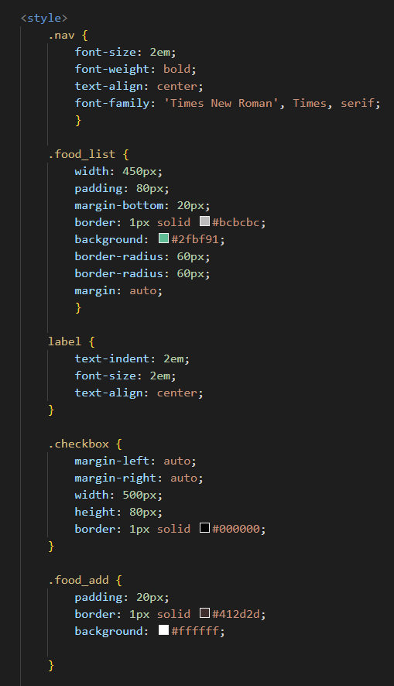
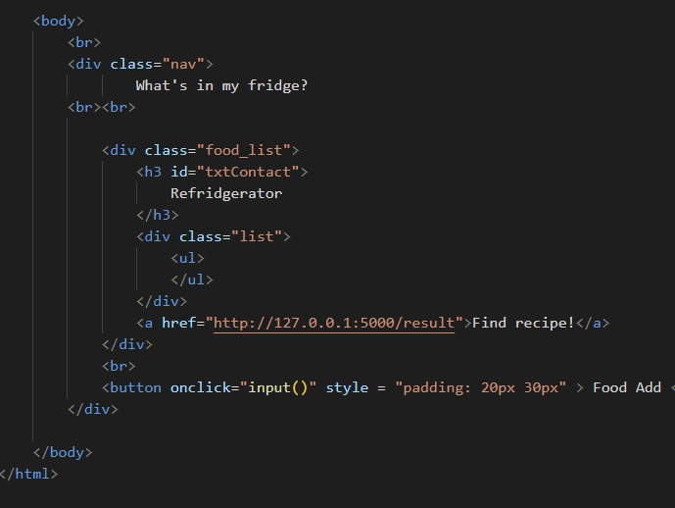
CSS
html
Java Script

Slide 9
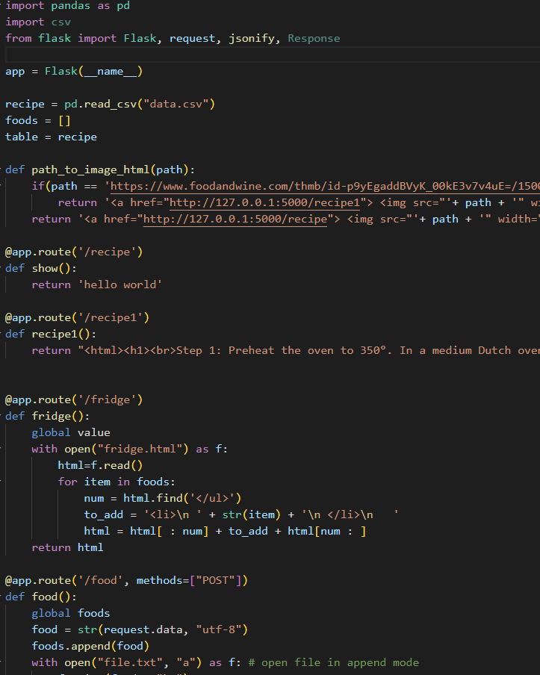
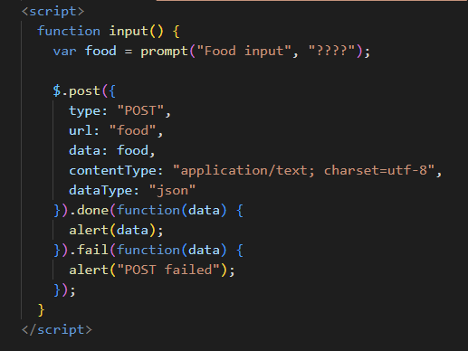
python
Java Script

Slide 10
04
Limitations
Due to time constraints, the login and save/like functions were not implemented.
Encountering difficulties by using skills that were not taught at school.
We had no choice but to use the local host.
Since the data was collected by ourselves, we couldn't handle a large amount of data.

Slide 11
Q&A

Slide 12
THANKS
Cheryn Kim
Clara Kim
Haneul Kim
Kyungmi Kim

